Slide 1
SWE2301:Introduction to software engineering
Lecture 03: Software Requirements
Venue: CIT Theater
Time: 10-1pm
Presented by M. I. Mukhtar

Slide 2
Lecture Outline
Requirement Engineering
Requirement Elicitation and analysis
Requirement Validation
Requirement Management.

Slide 3
Requirements engineering
The process of establishing the services that the customer requires from a system and the constraints under which it operates and is developed.
The requirements themselves are the descriptions of the system services and constraints that are generated during the requirements engineering process.

Slide 4
What is a requirement?
It may range from a high-level abstract statement of a service or of a system constraint to a detailed mathematical functional specification.
This is inevitable as requirements may serve a dual function
May be the basis for a bid for a contract - therefore must be open to interpretation;
May be the basis for the contract itself - therefore must be defined in detail;
Both these statements may be called requirements.

Slide 5
Requirements abstraction (Davis)
“If a company wishes to let a contract for a large software development project, it must define its needs in a sufficiently abstract way that a solution is not pre-defined. The requirements must be written so that several contractors can bid for the contract, offering, perhaps, different ways of meeting the client organization’s needs. Once a contract has been awarded, the contractor must write a system definition for the client in more detail so that the client understands and can validate what the software will do. Both of these documents may be called the requirements document for the system.”

Slide 6
Types of requirement
User requirements
Statements in natural language plus diagrams of the services the system provides and its operational constraints. Written for customers.
System requirements
A structured document setting out detailed descriptions of the system’s functions, services and operational constraints. Defines what should be implemented so may be part of a contract between client and contractor.

Slide 7
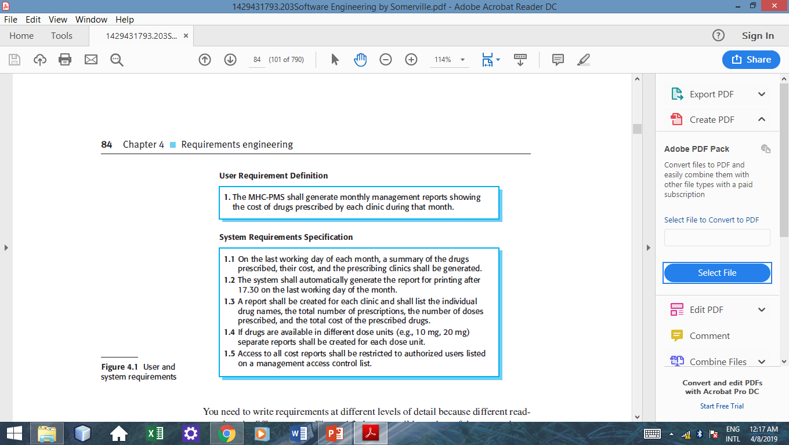
User and System requirements

Slide 8
Functional and non-functional requirements
Functional requirements
Functional user requirements may be high-level statements of what the system should do.
Examples:
A user shall be able to search the appointments lists for all clinics.
The system shall generate each day, for each clinic, a list of patients
Non-functional requirements
These define system properties and constraints e.g. reliability, response time and storage requirements. Constraints are I/O device capability, system representations.
Non-functional requirements may be more critical than functional requirements. If these are not met, the system may be useless.

Slide 9
The software requirements document
The software requirements document is the official statement of what is required of the system developers.
Should include both a definition of user requirements and a specification of the system requirements.
It is NOT a design document. As far as possible, it should set of WHAT the system should do rather than HOW it should do it.

Slide 10
Requirements Engineering Processes
The processes used for RE vary widely depending on the application domain, the people involved and the organisation developing the requirements.
However, there are a number of generic activities common to all processes
Requirements elicitation and analysis
Requirements validation;
Requirements management.
In practice, RE is an iterative activity in which these processes are interleaved.

Slide 11
Requirements elicitation and analysis
Sometimes called requirements elicitation or requirements discovery.
Involves technical staff working with customers to find out about the application domain, the services that the system should provide and the system’s operational constraints.
May involve end-users, managers, engineers involved in maintenance, domain experts, trade unions, etc. These are called stakeholders.

Slide 12
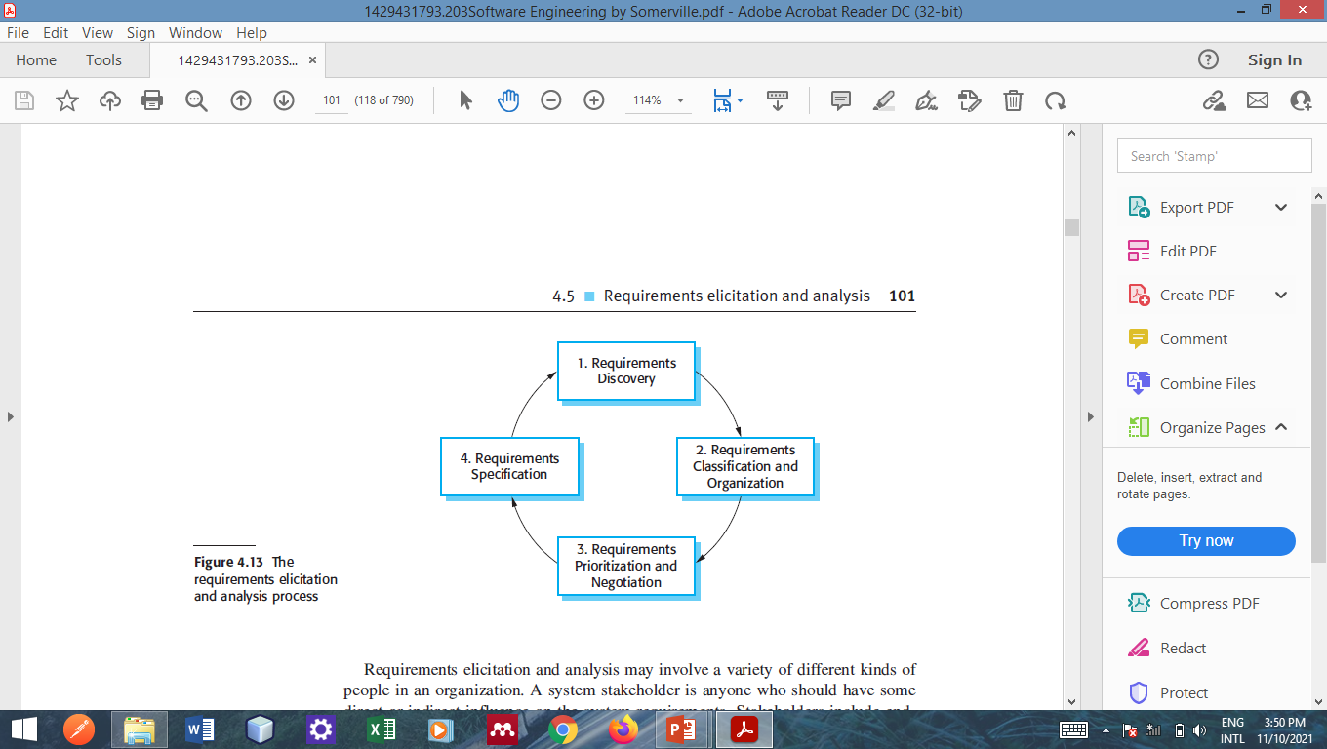
Requirements elicitation and analysis
Software engineers work with stakeholders to find out about the system to develop
Stages include:

Slide 13
Process activities
Requirements discovery
Interacting with stakeholders to discover their requirements.
Requirements classification and organisation
Groups related requirements and organises them into coherent clusters.
Prioritisation and negotiation
Prioritising requirements and resolving requirements conflicts.
Requirements specification
Requirements are documented and input into the next round of the spiral.

Slide 14
Requirements Discovery
The process of gathering information about the required and existing systems and distilling the user and system requirements from this information.
Interaction is with system stakeholders from managers to external regulators.
Systems normally have a range of stakeholders.
Example a hospital Management system may have stakeholders as: Patients, Doctors, Nurses, Medical receptionists and IT staff

Slide 15
Requirements Discovery
There are a number of requirement elicitation methods:
Interviews
Brainstorming sessions
Use case Approach
Ethnography
Questionnaire

Slide 16
Interviewing
Formal or informal interviews with stakeholders are part of most RE processes.
Types of interview
Closed interviews based on pre-determined list of questions.
Open interviews where various issues are explored with stakeholders.

Slide 17
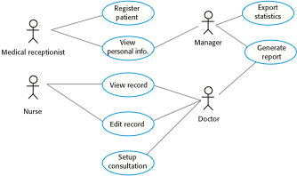
Use cases
Use-cases are a scenario based technique in the UML which identify the actors in an interaction and which describe the interaction itself.

Slide 18
Ethnography
A social scientist spends a considerable time observing and analysing how people actually work.
People do not have to explain or articulate their work.
Social and organisational factors of importance may be observed.
Ethnographic studies have shown that work is usually richer and more complex than suggested by simple system models.

Slide 19
Problems of requirements elicitation and analysis
Stakeholders do not know what they really want.
Stakeholders express requirements in their own terms.
Different stakeholders may have conflicting requirements.
Organisational and political factors may influence the system requirements.
The requirements change during the analysis process. New stakeholders may emerge and the business environment may change.

Slide 20
Requirements validation
Concerned with demonstrating that the requirements define the system that the customer really wants.
Requirements error costs are high so validation is very important.
Requirements validation is the process of checking the requirements for validity, consistency, completeness, realism, and verifiability.
Notes:
Fixing a requirements error after delivery may cost up to 100 times the cost of fixing an implementation error.

Slide 21
Requirements validation techniques
Requirements reviews
Systematic manual analysis of the requirements.
Prototyping
Using an executable model of the system to check requirements.
Test-case generation
Developing tests for requirements to check testability.
Notes:
If a test is difficult or impossible to design, this usually
means that the requirements will be difficult to implement and should be reconsidered. you
rarely find all requirements problems during the requirements validation process. It
is inevitable that there will be further requirements changes to correct omissions and
misunderstandings after the requirements document has been agreed upon.

Slide 22
Requirements Management
Requirements management is the process of managing changing requirements during the requirements engineering process and system development.
New requirements emerge as a system is being developed and after it has gone into use.
You need to keep track of individual requirements and maintain links between dependent requirements so that you can assess the impact of requirements changes.

Slide 23
Requirements change management
Deciding if a requirements change should be accepted
Problem analysis and change specification
During this stage, the problem or the change proposal is analyzed to check that it is valid. This analysis is fed back to the change requestor who may respond with a more specific requirements change proposal, or decide to withdraw the request.
Change analysis and costing
The effect of the proposed change is assessed using traceability information and general knowledge of the system requirements. Once this analysis is completed, a decision is made whether or not to proceed with the requirements change.
Change implementation
The requirements document and, where necessary, the system design and implementation, are modified. Ideally, the document should be organized so that changes can be easily implemented.

Slide 24
Lecture Summary
The requirements engineering process answers “What” functionalities should the new system have.
Requirements for a software system set out what the system should do and define constraints on its operation and implementation.
RE involve common processes such as elicitation, analysis, validation and management.

Slide 25
Question ??

